Slide 1
Advanced Modeling for Distribution Planning with OpenDSS
Instructor
Roger C. Dugan Sr. Technical Executive Sacramento, California June 22-23, 2017

Slide 2

Instructor
Roger C. Dugan, Life Fellow, IEEE
Roger is a Sr. Technical Executive with EPRI in Knoxville, Tennessee USA. He has over 45 years of combined experience in distribution engineering with EPRI, Electrotek Concepts, and Cooper Power Systems. He holds the BSEE degree from Ohio University and the Master of Engineering in Electric Power Engineering degree from Rensselaer Polytechnic Institute, Troy, NY. Roger has worked on many diverse aspects of power engineering over his career because of his interests in applying computer methods to power system simulation. Beginning with a student internship with Columbus and Southern Ohio Electric Co, his work has been focused on Distribution Engineering. He was elected a Fellow of the IEEE for his contributions in harmonics and transients analysis. Recently, he has been very active in distributed generation, particularly as it applies to utility distribution systems and distribution system analysis. He was the 2005 recipient of the IEEE Excellence in Distribution Engineering Award. He is coauthor of Electrical Power Systems Quality published by McGraw-Hill, now in its 3rd edition. He serves on the IEEE PES Distribution System Analysis Subcommittee and is active in the Distribution Test Feeders WG.

Slide 3
Custom Simulations

Slide 4
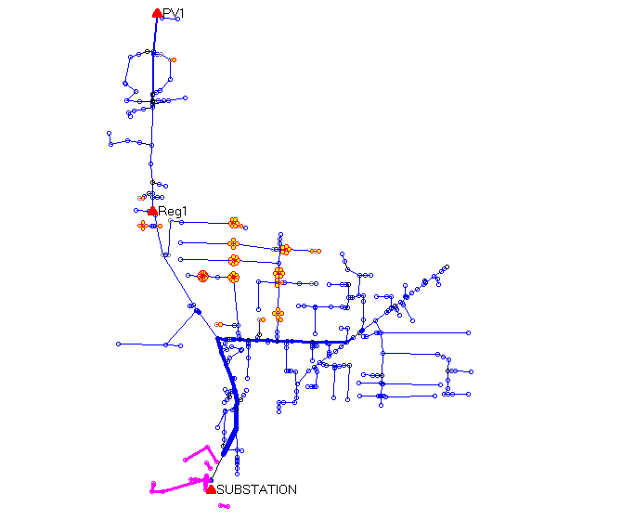
A Co-simulation Example (A Hypothetical Case)
PV Location (2.5 MW)
Voltage regulator
Clusters of
Storage Units
Ref: EPRI/AEP Smart Grid Demo
Community Energy Storage Concept

Slide 5
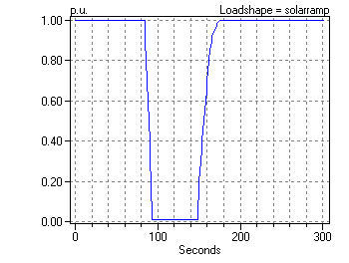
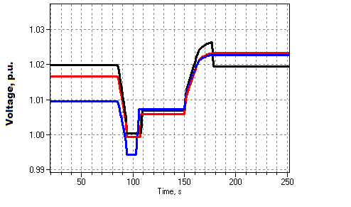
Solar Ramp Rate Issue
Assumed Solar Ramping Function
Result

Slide 6
The Question
Can you dispatch the 84 CES units fast enough to compensate for the sudden loss of PV generation on a “Cloud Transient” ?
Why it might not work:
Communications latency
CES not in right location or insufficient capacity
Calls for a “Hybrid” simulation
Communications network (NS2)
Distribution network (OpenDSS)

Slide 7
How We Did It

Slide 8
OpenDSS Script (Snippet)
Set sec=20
Solve ! Init steady state at t=20
Sample
! Start the ramp down at 1 sec
Set sec=21
Generator.PV1.kW=(2500 250 -) ! Decrement 10%
Solve
Sample
Set sec=22
Generator.PV1.kW=(2500 500 -) ! Decrement another 10%
Solve
Sample
Set sec = 22.020834372 ! Unit 1 message arrives
storage.jo0235001304.state=discharging %discharge=11.9
Solve
Sample
Set sec = 22.022028115 ! Unit 2 message arrives
storage.jo0235000257.state=discharging %discharge=11.9
Solve
Sample
Etc.

Slide 9
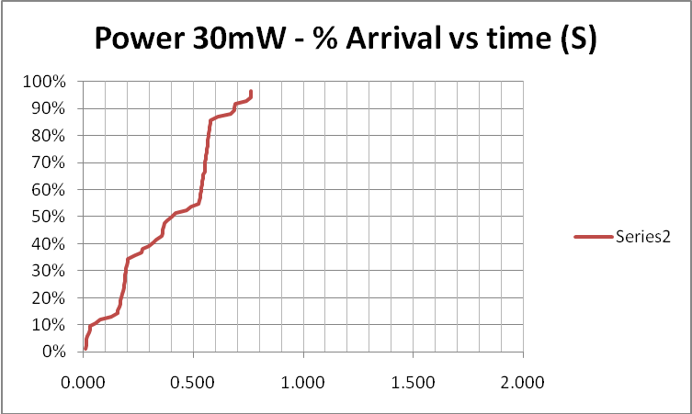
Results (for down ramp only)
Comm Simulation

Slide 10
Comm and Power Co-simulation
New and active research area
Working to more tightly link ns-2 and OpenDSS
Or other comm simulators
Communications latency is an important issue with Smart Grid
Power engineers tend to assume communications will happen
But there are limits

Slide 11
Custom Simulation Scripting in Snapshot Mode
This is the default solution mode
Attempts one solution for each “solve”
Solves the circuit “as is”
If you want something done, you have to specifically tell it
Set Load and Generator kW, etc.
Load.MyLoad.kW=125
Loadshapes are not used in this mode!
Sample Monitors and meters
Solve
Sample

Slide 12
Custom Simulation Scripting in “Time” Mode
Similar to Snapshot mode EXCEPT:
Loads, Generators can follow a selected Loadshape
Duty, Daily, or Yearly
Monitors are automatically sampled
But not Energymeters; do that explicitly if desired
Time is automatically incremented AFTER solve

Slide 13
Snapshot Mode Scripting Example
Set Gen kW explicitly each time step
! Start the ramp down at 1 sec
Set sec=1
Generator.PV1.kW=(2500 250 -)
Solve
Sample
Set sec=2
Generator.PV1.kW=(2500 500 -)
Solve
Sample
Set sec = 2.020834372 ! Unit 1
storage.jo0235001304.state=discharging %discharge=11.9
Solve
Sample
Set sec = 2.022028115 ! Unit 2
storage.jo0235000257.state=discharging %discharge=11.9
Solve
Sample
Set sec = 2.023158858 ! Unit 3
storage.jo0235000265.state=discharging %discharge=11.9
Solve
Sample
Set sec = 2.024604602 ! Unit 4
storage.jo0235000268_1.state=discharging %discharge=11.9
Solve
Sample
Set sec = 2.025738325 ! Unit 5
storage.jo0235000268_2.dispmode=discharging %discharge=11.9
Solve
Sample
Etc.
Solve and Sample explicitly at each step
Set each Storage unit discharge rate explicitly each time step
(time is used for recording purposes only)

Slide 14
Time Mode Scripting Example
All Loads, Generators will follow assigned Duty cycle loadshape
! Start the ramp down at 1 sec
Set mode=time loadshapeclass=duty
set stepsize=1s
Solve ! Base case t=0
Solve ! t=t+1 = 2
Solve ! t=2 second solution; t=t+1 = 3
Set sec = 2.020834372 ! Unit 1 (reset t)
storage.jo0235001304.state=discharging %discharge=11.9
Solve
Set sec = 2.022028115 ! Unit 2
storage.jo0235000257.state=discharging %discharge=11.9
Solve
Set sec = 2.023158858 ! Unit 3
storage.jo0235000265.state=discharging %discharge=11.9
Solve
Set sec = 2.024604602 ! Unit 4
storage.jo0235000268_1.state=discharging %discharge=11.9
Solve
Set sec = 2.025738325 ! Unit 5
storage.jo0235000268_2.dispmode=discharging %discharge=11.9
Solve
Etc.
Set sec=3
Solve ! t=3 solution; t=t+1 = 4
….

Slide 15
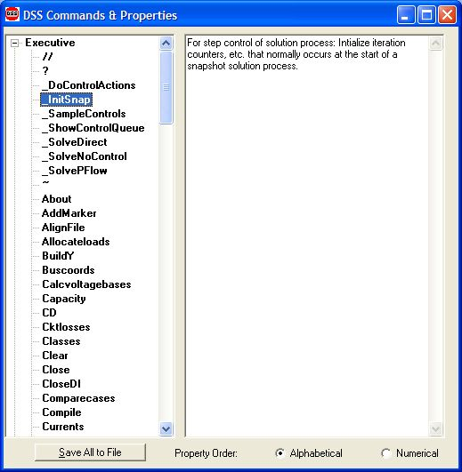
Custom Simulation Scripting: Rolling Your Own Solution Algorithm
These commands allow step-by-step control of the solution process

Slide 16
Custom Simulation Scripting: Rolling Your Own Solution Algorithm
The basic Snapshot solution process:
Initialize Snapshot (_InitSnap)
Repeat until converged:
Solve Circuit (_SolveNoControl)
Sample control devices (_SampleControls)
Do control actions, if any (_DoControlActions)
You may wish, for example, to interject custom control actions after the _SolveNoControl step

Slide 17
OpenDSS Solution Loop with Controls
Controls are sampled and executed after a converged power flow solution
_SolveNoControl
_SampleControls
_DoControlActions

Slide 18
Co-simulation and OpenDSS
Simulation of power system and communications networks simultaneously
An important area of smart grid research
Will messages be able to get to targets in time to perform Smart Grid functions?
What will be the effect of communications latency?
Much work needs to be done developing appropriate tools

Slide 19
Custom Simulation Scripting, cont’d
Via COM interface
Whatever you want (if you can write code)
See Examples Folder on Sourceforge site
Excel: SampleDSSDriver.xls
Matlab:
VoltageProfileExample.m
DSSMonteCarlo.m

Slide 20
For More Information …
See OpenDSS Custom Scripting.Doc
(Sourceforge site, “Doc” Folder)

